Slide 1

Visual Displays of Data
Chapter 3

Slide 2
Uses of Graphs
Positive and negative uses
Can accurately and succinctly present information
Can reveal/conceal complicated data
Graphing in the information age: a critical skill
http://www.datavis.ca/gallery/

Slide 3
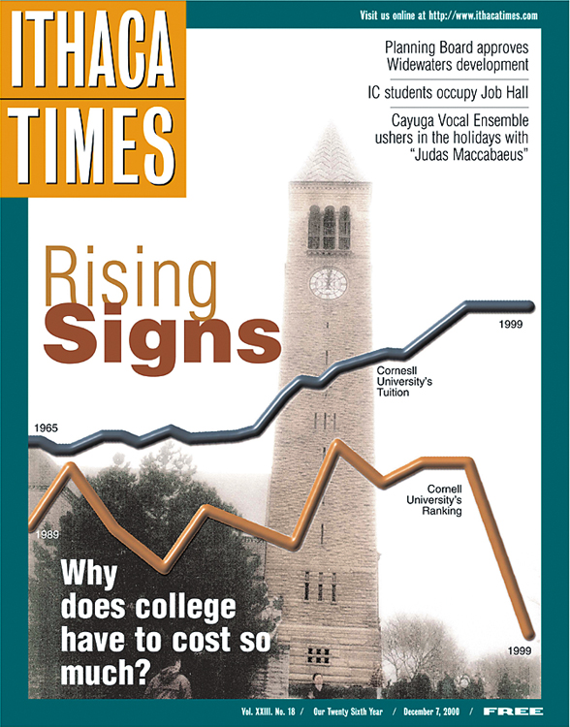
“The Most Misleading Graph Ever Published” The Cost and Quality of Higher Education
How to Mislead with Graphs

Slide 4
“The Most Misleading Graph Ever Published” The Cost and Quality of Higher Education
So why bad?
The times are not the same for both lines (going across)
The scales are not the same
So the starting point is also a problem
Rankings … down = BETTER, so why did they graph ranks that way?

Slide 5
Techniques for Misleading
The false face validity lie
Method seems to represent what it says, but does not actually.
e.g., using yelling as a measure of aggression
The biased scale lie
Scaling to skew the results, or leading questions
i.e. goodreads book scale (did not like, it was ok, liked it, really liked it, it was amazing)
The sneaky sample lie
When participants are preselected or self selected to provide data.
Like rate my professor!

Slide 6
More Techniques
The interpolation lie
Assumes that a value between 2 data points follows the same pattern
The extrapolation lie
Assumes knowledge outside of the study
The inaccurate values lie
Uses scaling to distort portions of the data
The outright lie:
Making up data!

Slide 7
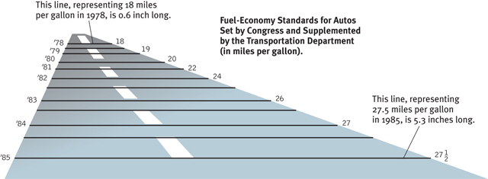
The Inaccurate Value Lie

Slide 8
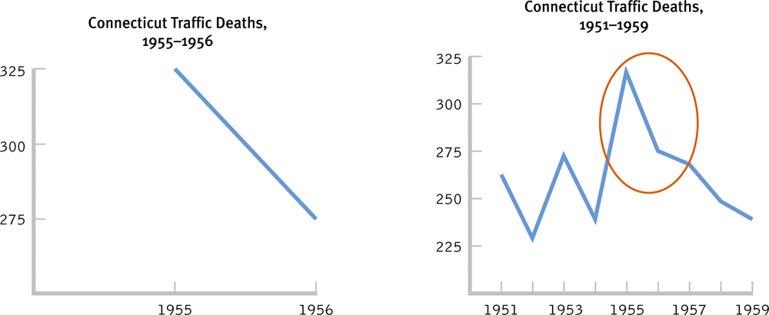
Which of the two graphs is misleading?

Slide 9
Common Types of Graphs
Scatterplots
Graphs that depict the relation between two scale variables
Range-frame (!!) – x and y axis show the range of the variable
Eep?
Observing every data point
Linear relationships – relationship between variables is a straight line
Nonlinear relationships – relationship between variables is curved
Performance & Anxiety

Slide 10
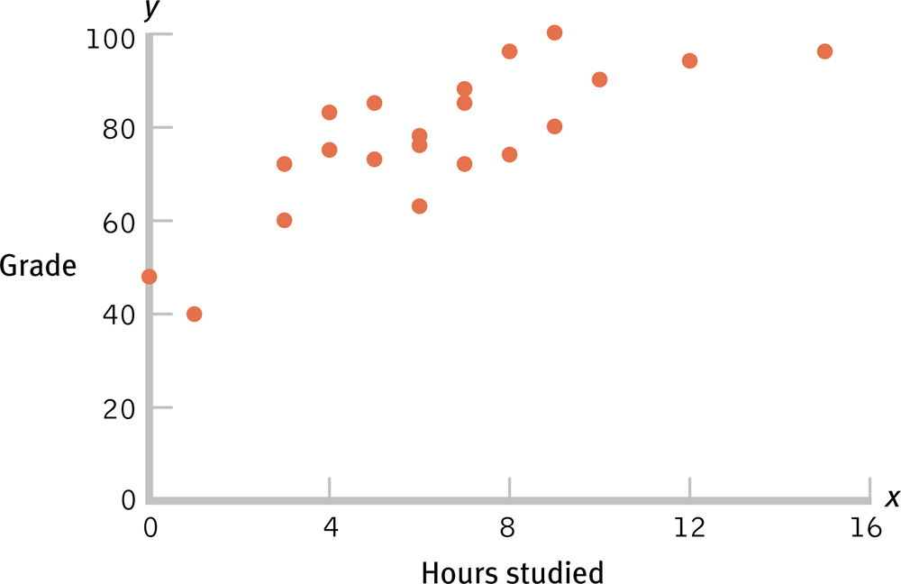
Scatterplot of Hours Studied and Statistics Grade

Slide 11
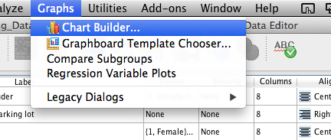
SPSS Scatterplots
Graphs > chart builder
Hit ok if you get a define message

Slide 12
SPSS Scatterplots
Click scatter / dot on the left hand side
DOUBLE click or drag the first box (top left) to the design window

Slide 13
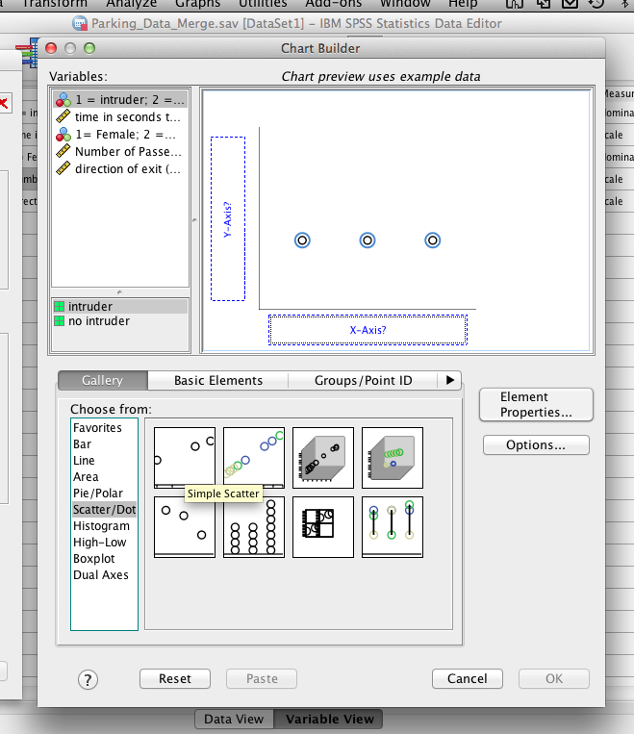
SPSS Scatterplots

Slide 14
SPSS Scatterplots
Drag a variable into X and a variable into Y

Slide 15
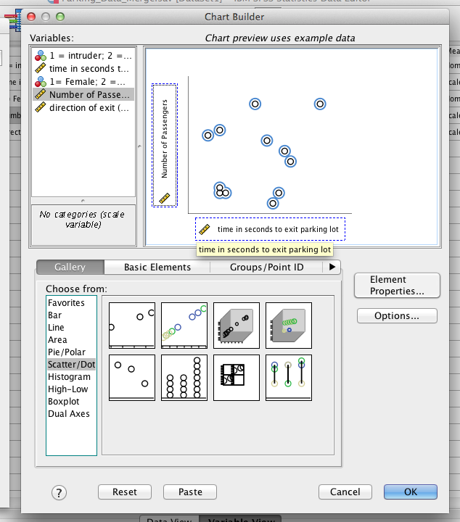
SPSS Scatterplots

Slide 16
SPSS Scatterplots
Hit ok!
(please note that the picture it creates for you IS NOT the real scatterplot).

Slide 17
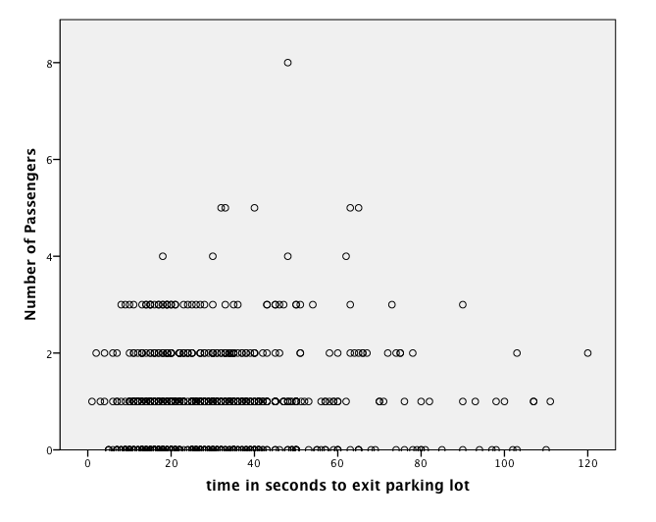

Slide 18
Line Graphs
Line graphs are best for scale variables (remember this is interval/ratio)
Especially useful for trends over time
Line of best fit
Time series plot

Slide 19
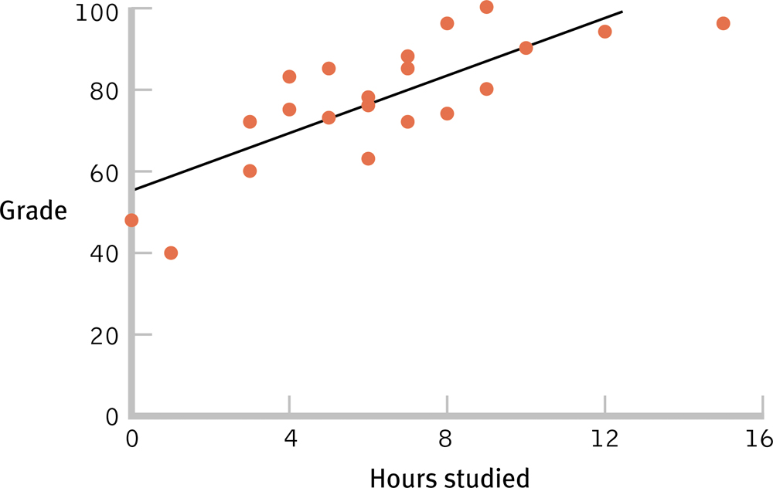
The Line of Best Fit

Slide 20
SPSS Line of Best Fit
Double click on your scatterplot and new window will pop up

Slide 21
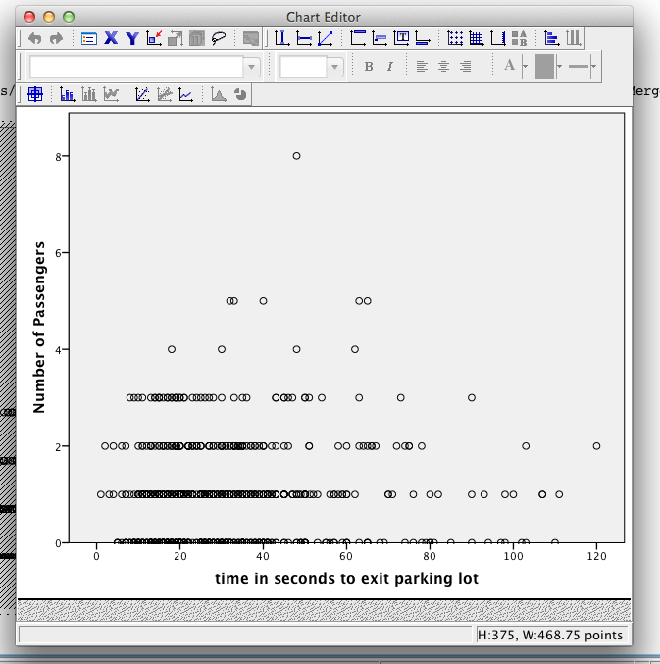

Slide 22
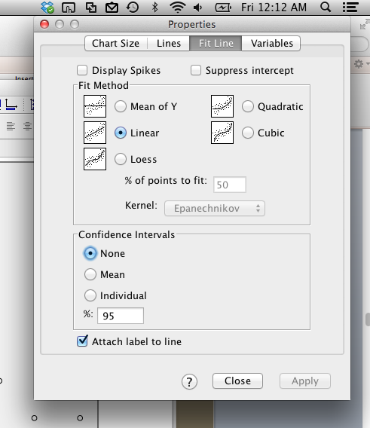

Slide 23
SPSS Line of Best Fit
Hit close and then also close the pop up window to get the line in the output file.

Slide 24
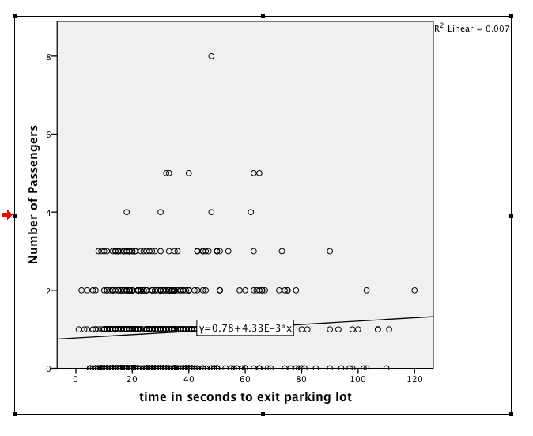

Slide 25
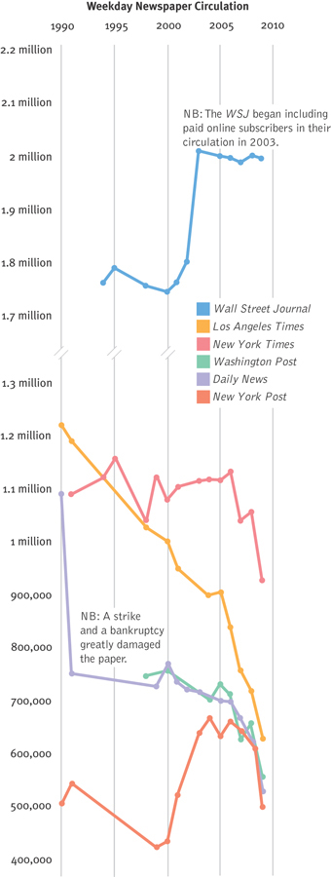
Weekly Newspaper Circulation

Slide 26
SPSS Line Graphs
Graphs > chart builder
Click line on the left
Select the first box (double click or drag and drop)
Drag one variable in X and one in Y

Slide 27
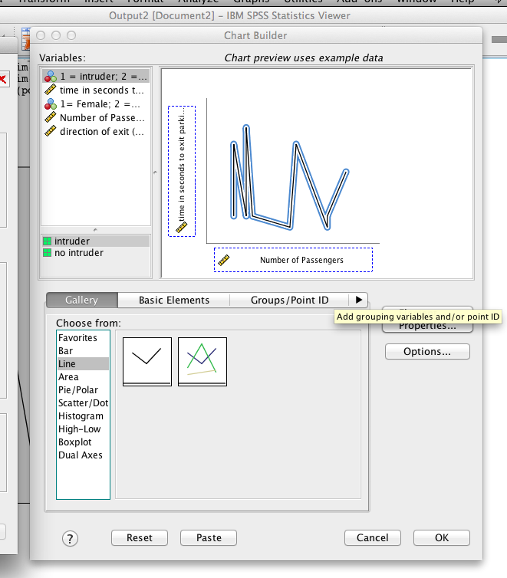

Slide 28
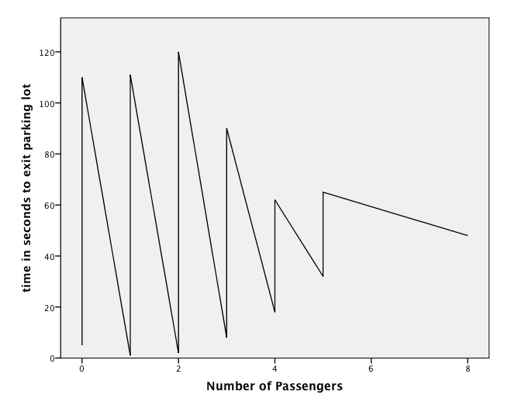

Slide 29
Bar Graphs
When the independent variable is nominal or ordinal and the dependent variable is scale
Meaning X = groups, Y = interval/ratio
Each bar usually represents and AVERAGE score.
Pareto chart: bar graph in which categories along the x-axis are ordered from highest to lowest
(I have never heard this term before, so if you see a question on it in the homework let me know so I can take it out).

Slide 30
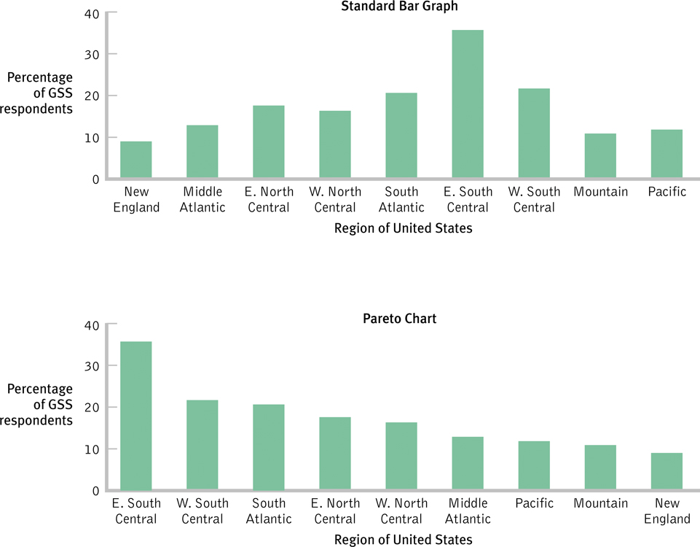
The Flexibility of the Bar Graph

Slide 31
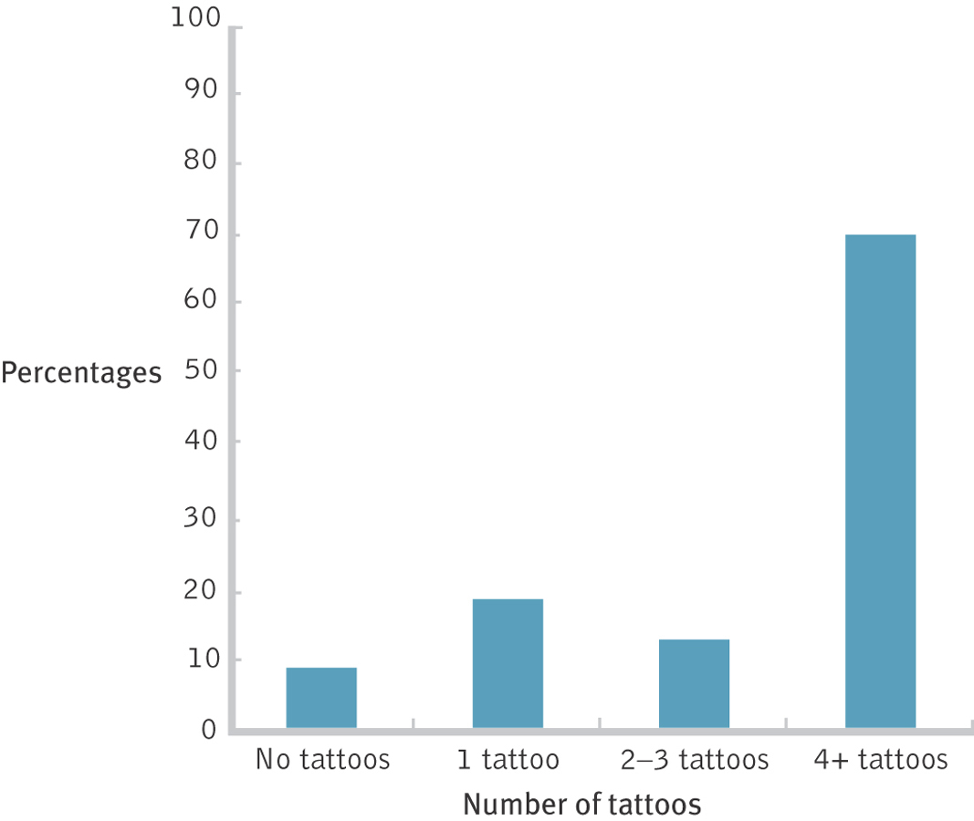
Bar Graphs Highlight Differences Between Means

Slide 32
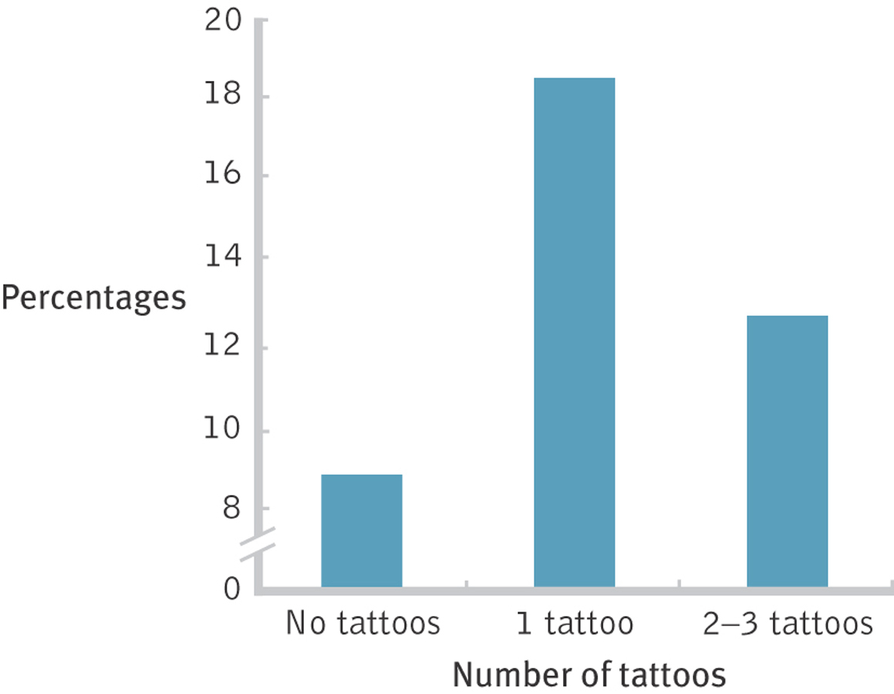
Deceiving with the Scale

Slide 33
SPSS Bar Graphs
Graphs > chart builder
Click bar on the left.
Select the first option (double click or drag and drop).
Put a categorical variable in X, a continuous variable in Y.

Slide 34
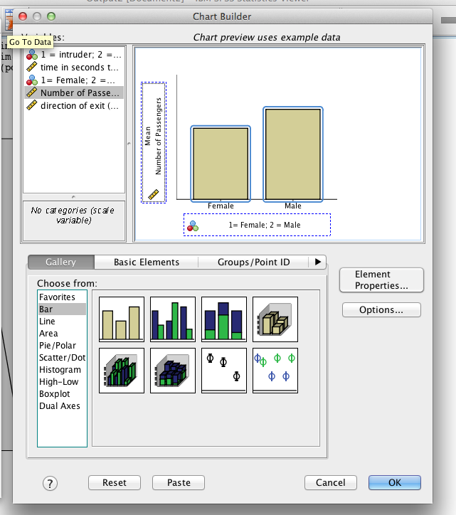

Slide 35
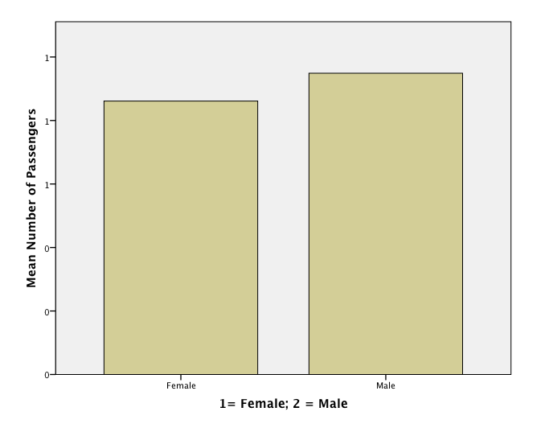

Slide 36
Two others
Pictorial graphs
Meh?
Pie Charts
I think you are all smart enough to know what a pie chart is … as well as they are not really used in research papers (frequency charts!)
So we are going to leave these out.

Slide 37
Frequency Polygons / Histograms
Graphs > chart builder
Select histogram
Histogram = first box, frequency polygon = third box
This is different: only put something in X…

Slide 38
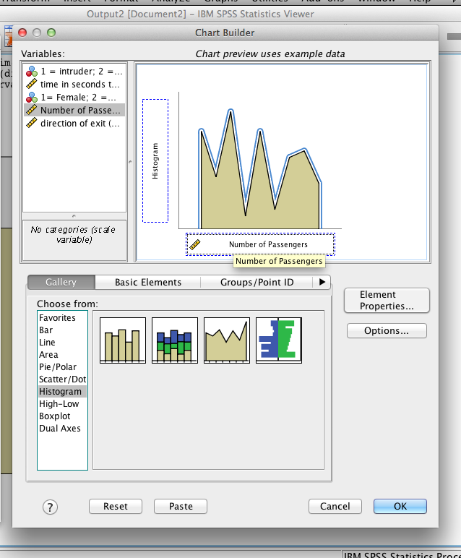

Slide 39
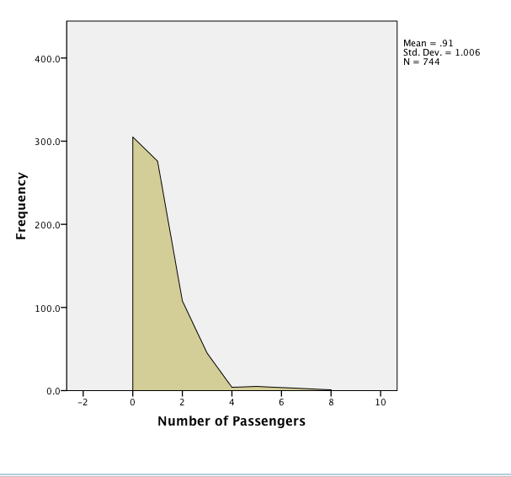

Slide 40
Check Your Learning
What is the best type of graph to depict the following:
Depression levels and stress levels for 150 university students. Is depression related to stress?
Mean years of education for six regions of the United States. Are education levels higher in some regions than in others?

Slide 41
Choosing the Graph Based on Variables
One scale variable (with frequencies): histogram or frequency polygon
One scale independent and one scale dependent variable: scatterplot or line graph
One nominal or ordinal independent and one scale dependent variable: bar graph
Two+ nominal or ordinal independent and one interval dependent variable: bar graph

